Slide 1
PART ONE
Introduction to E-commerce
Chapter 1: The evolution of E-commerce
Chapter 2: E-commerce business models and concepts

Slide 2
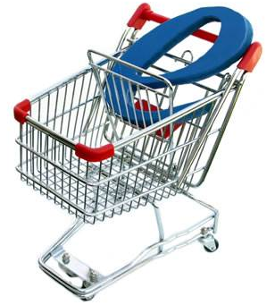
Chapter 2: E-commerce business models and concepts

Slide 3
Learning Objectives
- Identify the key components of E-commerce business models.
- Describe the major B2C business models.
- Describe the major B2B business models.
- Recognize business models in other emerging areas of E-commerce.
- Understand key business concepts and strategies applicable to E-commerce.

Slide 4
E-COMMERCE BUSINESS MODELS
What is business model?
A set of planned activities designed to result in a profit in a marketplace.
What is business plan?
A document that describes a firm’s business model.
What is E-commerce business model?
A business model that aims to use and leverage the unique qualities of the internet and the World Wide Web.

Slide 5
EIGHT KEY ELEMENT OF A BUSINESS MODEL
1- Value Proposition: How a company’s product or service fulfills the needs of customers. Typical E-commerce value propositions include personalization, customization, convenience, and reduction of product search and price delivery costs.
2- Revenue Model: How the company plans to make money from its operations. Major E-commerce revenue models include the advertising model, subscription model, transaction fee model, sales model, and affiliate model.

Slide 6
EIGHT KEY ELEMENT OF A BUSINESS MODEL (Cont.)
3- Market Opportunity: The revenue potential within a company’s intended market-space.
4- Competitive Environment: The direct and indirect competitors doing business in the same market-space, including how many there are and how profitable they are.

Slide 7
EIGHT KEY ELEMENT OF A BUSINESS MODEL (Cont.)
5- Competitive Advantage: The factors that differentiate the business from its competition, enabling it to provide a superior product at a lower cost.
6- Market Strategy: The plan a company develops that outlines how it will enter a market and attract customers.

Slide 8
EIGHT KEY ELEMENT OF A BUSINESS MODEL (Cont.)
7- Organizational Development: The process of defining all the functions within a business and the skills necessary to perform each job, as well as the process of recruiting and hiring strong employees.
8- Management Team: The group of individuals retained to guide the company’s growth and expansion.

Slide 9
FIVE PRIMARY REVENUE MODELS
REVENUE MODEL
EXAMPLES
REVENUE SOURCE
1- Advertising
Yahoo
Fees from advertiser in exchange for advertisements.
2- Subscription
WSJ.com Consumerreport.org
Fees from subscribers in exchange for access to content or services.
3- Transaction Fee
eBay E-trade
Fees (commissions) for enabling or executing a transaction.
4- Sales
Amazon LLBean Gap JCPenny.com
Sales of good, information, or services.
5- Affiliate
MyPoint
Fees for business referrals

Slide 10
MAJOR BUSINESS-TO-CONSUMER (B2C) BUSINESS MODELS
Portal: Offers powerful search tools plus an integrated package of content and services; typically utilizes a combined subscription /advertising revenue/transaction fee model; maybe general or specialized.
E-tailer: Online version of traditional retailer; includes virtual merchants (online retail store only), bricks-and-clicks E-tailers (online distribution channel for a company that also has physical store), catalog merchants (online version of direct mail catalog), and manufacturers selling directly over the Web.

Slide 11
MAJOR BUSINESS-TO-CONSUMER (B2C) BUSINESS MODELS (Cont.)
Content Provider: Information and entertainment companies that provide digital content over the Web; typically utilizes and advertising, subscription, or affiliate referral fee revenue model.
Transaction Broker: Processes online sales transactions; typically utilizes a transaction fee revenue model.

Slide 12
MAJOR BUSINESS-TO-CONSUMER (B2C) BUSINESS MODELS (Cont.)
Market Creator: Uses internet technology to create markets that bring buyers and sellers together; typically utilizes a transaction fee revenue model.
Service Provider: Offers services online.
Community Provider: Provides an online community of like-minded individuals for networking and information sharing; revenue is generated by advertising, referral fees, and subscription.

Slide 13
MAJOR BUSINESS-TO-BUSINESS (B2B) BUSINESS MODELS
E-distributor: A company that supplies products and services directly to individual business.
E-procurement: Single firms create digital markets for thousands of sellers and buyers.
Exchange: Independently owned digital marketplace for direct inputs, usually for a vertical industry group.
Industry Consortium: Industry-owned vertical digital market.
Private Industrial Network: Industry-owned private industrial network that coordinates supply chains with a limited set of partners.

Slide 14
MAJOR BUSINESS-TO-BUSINESS (B2B) BUSINESS MODELS (Cont.)
BUSINESS MODEL
EXAMPLES
DESCRIPTION
REVENUE MODEL
1- Net Marketplace
E-distributor
Grainger.com, Partstore.com
Single-firm online version of retail and wholesale store; supply maintenance, repair, operation goods; indirect inputs.
Sales of goods
E-procurement
Ariba, Perfectcommerce
Single-firm creating digital markets where sellers and buyers transact for indirect inputs.
Fees for market-making services; supply chain management, and fulfillment service.
Exchange
Farms.com, Foodtrader
Independently-owned vertical digital marketplace for direct inputs.
Fees and commissions on transactions.
Industry Consortium
Elemica, Exostar, Quadream
Industry-owned vertical digital market open to select suppliers.
Fees and commissions on transactions.
2- Private Industrial Network
Single firm
Wal-Mart Proctor & Gamble
Company-owned network to coordinate supply chains with a limited set of partners.
Cost absorbed by network owner and recovered through production and distribution efficiencies.
Industry-Wide
1 SYNC Agentrics
Industry-owned network to set standards, coordinate supply and logistics for the industry.
Contributions from industry member firms and recovered through production and distribution efficiencies; fees for transactions and services.

Slide 15
BUSINESS MODELS IN EMERGING E-COMMERCE AREAS
When we think about a business, we typically think of a business firm that produces a products or good, and then sells it to a customer.
But the Web has forced us to recognize new forms of business, such as consumer-to-consumer E-commerce, peer-to-peer E-commerce, and M-commerce.

Slide 16
BUSINESS MODELS IN EMERGING E-COMMERCE AREAS
C2C business models: Connect consumers with other consumers. Provide a way for consumers to sell to each other, with the help of an online business. The first and best example of this type of business is eBay, utilizing a market creator business model.
P2P business models: Enable consumers to share files and services via the Web without common servers.
M-commerce business models: Take traditional E-commerce models and leverage emerging wireless technologies to permit mobile access to the Web.

Slide 17
BUSINESS MODELS IN EMERGING E-COMMERCE AREAS (Cont.)
E-commerce enablers: focus on providing the infrastructure necessary for E-commerce companies to exist, grow, and prosper.

Slide 18
BUSINESS MODELS IN EMERGING E-COMMERCE AREAS (Cont.)
E-commerce enablers
Infrastructure
Players
Hardware: Web Servers
IBM, HP, Dell, Sun
Software: Operation Systems and Server Software
Microsoft, RedHat Linux, Sun, Apache Software Foundation
Networking: Routers
Cisco, JDS Uniphase, Lucent
Security: Encryption Software
VeriSign, Check Point, Entrust, RSA
E-commerce Software Systems (B2C, B2B)
IBM, Microsoft, Ariba, BroadVision, BEA Systems
Streaming and Rich Media Solutions
Real Networks, Microsoft, Apple, Audible
Customer Relationship Management Software
Oracle, SAP, E.piphany
Payment Systems
VeriSign, PayPal, Cybersource
Performance Enhancement
Akamai, Kontiki
Databases
Oracle, Microsoft, Sybase, IBM
Hosting Services
Interland, IBM, WebIntellects, Quest

Slide 19
HOW THE INTERNET AND THE WEB CHANGE BUSINESS: STRATEGY, STRUCTURE, AND PROCESS
The Internet and the Web have had a major impact on the business environment in the last decade, and have affected:
- Industry structure
- Industry value chains
- Firm value chains
- Business strategy

Slide 20
What is Industry structure ?
The nature of players in an industry and their relative bargaining power by changing the basis of competition among rivals, the barriers to entry, the threat of new substitute products, the strength of suppliers, and the bargaining power of buyers.

Slide 21
How the internet influences industry structure
Threat of substitute Product or Services
Bargaining power of suppliers
Rivalry among existing competitors
Buyers
Barriers to entry

Slide 22
What is Industry value chains ?
The set of activities performed in an industry by suppliers, manufacturers, transporters, distributors, and retailers that transforms raw inputs into final products and services by reducing the cost of information and other transaction costs.

Slide 23
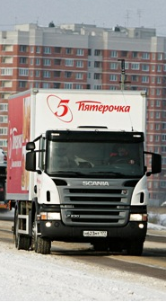
E-commerce and Industry value chains
Suppliers
Manufacturers
Distributors
Retailers
Customers
Efficient Customer Response Systems
Inventory Management Systems
Supply Chain Management Systems
TRANSPOTERS
Transportation Management Systems

Slide 24
What is Firm value chains ?
The set of activities perform within an individual firm to create final products from raw inputs by increasing operational efficiency.

Slide 25
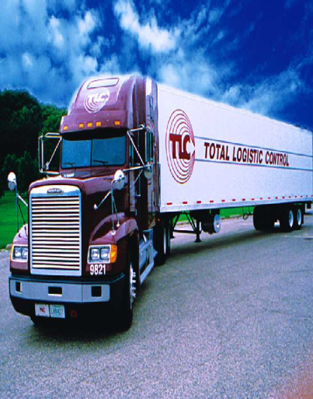
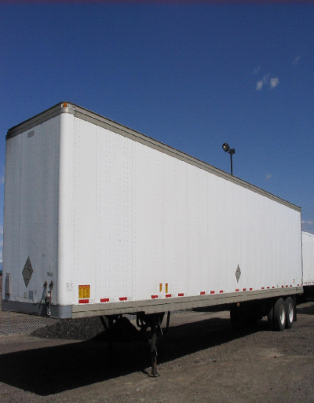
E-commerce and Firm value chains
Inbound Logistics
Outbound Logistics
Sales and Marketing
After Sales Service
Operation
Secondary Activities
Primary Activities
Administration, Human Resources, Information Systems, Procurement, Finance/Accounting

Slide 26
What is Business strategy ?
The set of plans for achieving superior long-term returns on the capital invested in a firm by offering unique ways to differentiate products, obtain cost advantages, compete globally, or compete in a narrow market or product segment.

Slide 27
INTERNET-ANABLED VALUE WEB
STRATEGIC ALLIANCE AND PARTNER FIRMS
ERP Systems, Legacy Systems
DIRECT SUPPLIERS
FIRM/INDUSTRY
CUSTOMERS
Supply Chain Management Systems: Private Industrial Networks, Net Market-Places
Customer Relationship Management (CRM) System
INDIRECT SUPPLIERS

Slide 28
QUESTIONS
1- What is a business model? How does it differ from a business plan?
2- What are the eight key components of an effective business model?
3- What are some of the specific ways that a company can obtain a competitive advantage?
4- What are some business models seen in the C2C and P2P E-commerce areas?
5- Who are the major players in an industry value chain and how are they impacted by E-commerce technology?
6- What are four generic business strategies for achieving a profitable business?

